Slide 1
Structure of Business Letter

Slide 2
Structure of Business Letter
Sender's Address
Date
Inside Address
Salutation
Body
Closing
Signature block

Slide 3
Standard Elements
Additional Elements
Letterhead and date
Inside address
Salutation
The body
Complimentary close
Signature block
Addressee notation
Attention line
Subject line
Reference initials
Reference line
Enclosure notation
Copy notation
Mailing notation
Postscript

Slide 4
Sender's Address
Sell Your House, Inc.
206 N. Sell Dr.
Richmond, VA 23218

Slide 5
Sender's Address
The sender's address usually is included in letterhead. If you are not using letterhead, include the sender's address at the top of the letter one line above the date. Do not write the sender's name or title, as it is included in the letter's closing. Include only the street address, city, and zip code.

Slide 6
Date
March 6, 2009
6 March 2009

Slide 7
Date
The date line is used to indicate the date the letter was written. However, if your letter is completed over a number of days, use the date it was finished in the date line. When writing to companies within the United States, use the American date format. (The United States-based convention for formatting a date places the month before the day. For example: June 11, 2001. ) Write out the month, date and year two inches from the top of the page. Depending which format you are using for your letter, either left justify the date or tab to the center point and type the date. In the latter case, include the sender's address in letterhead, rather than left-justified.

Slide 8
Inside Address
Angela Property
220 Corporation Way
Somwhereville, VA 22590

Slide 9
Inside Address
The inside address is the recipient's address. It is always best to write to a specific individual at the firm to which you are writing. If you do not have the person's name, do some research by calling the company or speaking with employees from the company. Include a personal title such as Ms., Mrs., Mr., or Dr. Follow a woman's preference in being addressed as Miss, Mrs., or Ms. If you are unsure of a woman's preference in being addressed, use Ms.

Slide 10
Inside Address
If there is a possibility that the person to whom you are writing is a Dr. or has some other title, use that title. Usually, people will not mind being addressed by a higher title than they actually possess. To write the address, use the U.S. Post Office Format. For international addresses, type the name of the country in all-capital letters on the last line. The inside address begins one line below the date. It should be left justified, no matter which format you are using.

Slide 11
Salutation
Dear Ms. Property:

Slide 12
Salutation
Use the same name as the inside address, including the personal title. If you know the person and typically address them by their first name, it is acceptable to use only the first name in the salutation (for example: Dear Lucy:). In all other cases, however, use the personal title and last/family name followed by a colon. Leave one line blank after the salutation.

Slide 13
Salutation
If you don't know a reader's gender, use a nonsexist salutation, such as their job title followed by the receiver's name. It is also acceptable to use the full name in a salutation if you cannot determine gender. For example, you might write Dear Chris Harmon: if you were unsure of Chris's gender.

Slide 14
Body
I hope that you are doing well. My name is Lydia Lease, and I am an attorney at Sell Your House, Inc. I am writing in regards to a parcel of land located at 225 Parcel St., Richmond, VA. My client, Mrs. Tabitha Land, is running into some difficulties in selling her property that is apparently still under lease by your organization.
This parcel of land (100 ft by 300 ft) is located at the back of my client's property. According to the city records, the lease was initiated in September 2001 and never terminated. After calling your lease office, it appears that you no longer make use of this property. In order for my client to be able to sell her property, the lease must be cleared. This parcel of land is still under your organization's name. I have attached the documents describing the lease and ask that you clear your name from this property as soon as possible.
My client is wishing to put her property on the market by April 2009. In order to do so, this parcel of land must be cleared from your organization's hold. I have enclosed the city's 1" documents concerning the ownership of this land as well as termination documents for your use. If you have any additional questions or concerns, please feel free to contact me at (123) 456-7890. I look forward to working with you to resolve this matter.

Slide 15
Body
For block and modified block formats, single space and left justify each paragraph within the body of the letter. Leave a blank line between each paragraph. When writing a business letter, be careful to remember that conciseness is very important. In the first paragraph, consider a friendly opening and then a statement of the main point. The next paragraph should begin justifying the importance of the main point. In the next few paragraphs, continue justification with background information and supporting details. The closing paragraph should restate the purpose of the letter and, in some cases, request some type of action.

Slide 16
Closing &
Signature block
Sincerely,
Lydia Lease, Attorney, Sell Your House, Inc.

Slide 17
Closing
The closing begins at the same vertical point as your date and one line after the last body paragraph. Capitalize the first word only (for example: Thank you) and leave four lines between the closing and the sender's name for a signature. If a colon follows the salutation, a comma should follow the closing; otherwise, there is no punctuation after the closing.

Slide 18
Enclosures
Enclosures: 2

Slide 19
Enclosures
If you have enclosed any documents along with the letter, such as a resume, you indicate this simply by typing Enclosures below the closing. As an option, you may list the name of each document you are including in the envelope. For instance, if you have included many documents and need to ensure that the recipient is aware of each document, it may be a good idea to list the names.

Slide 20
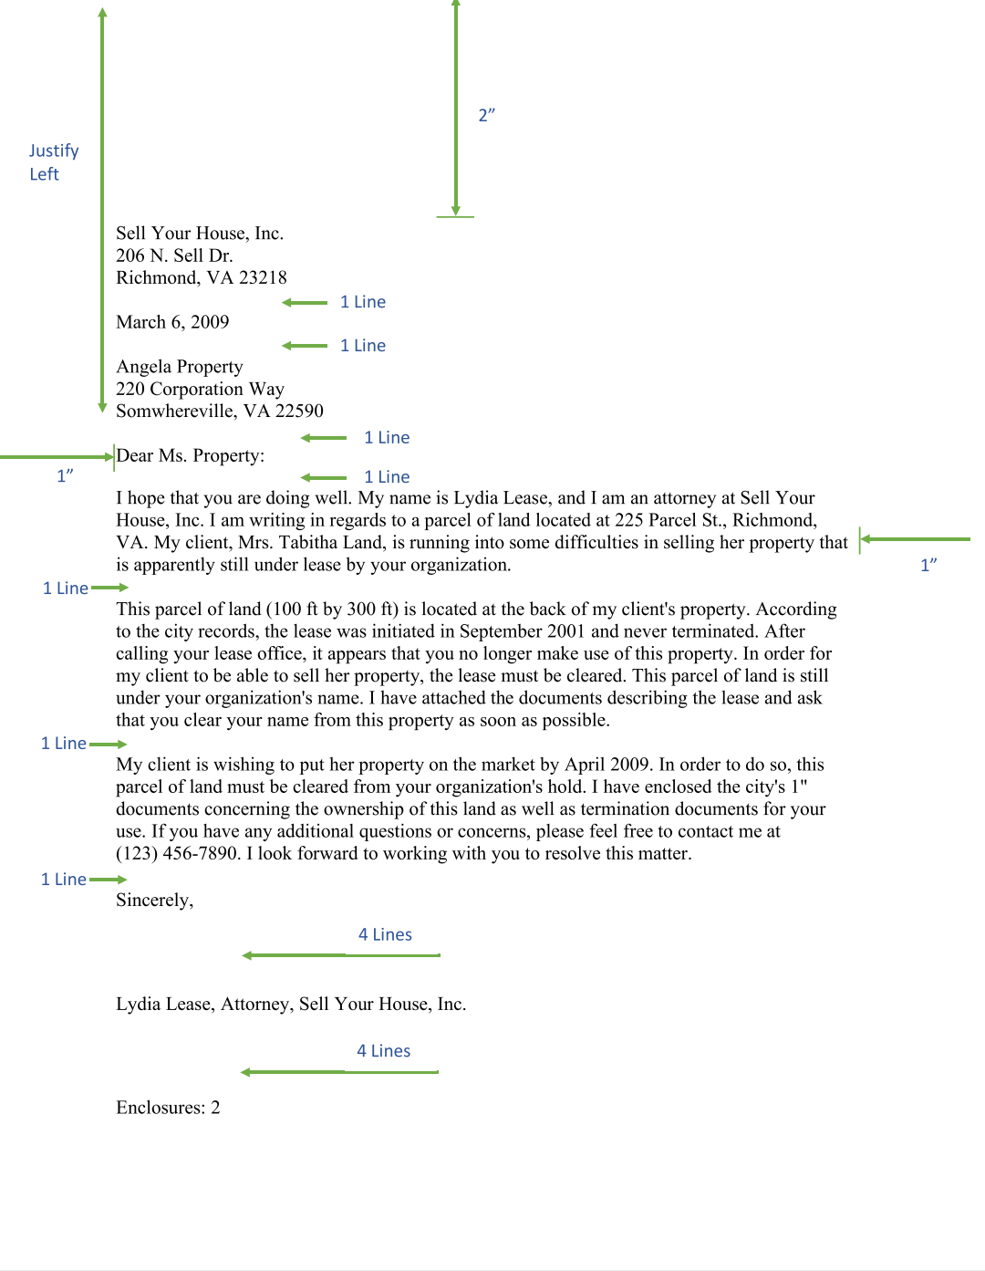

Slide 21
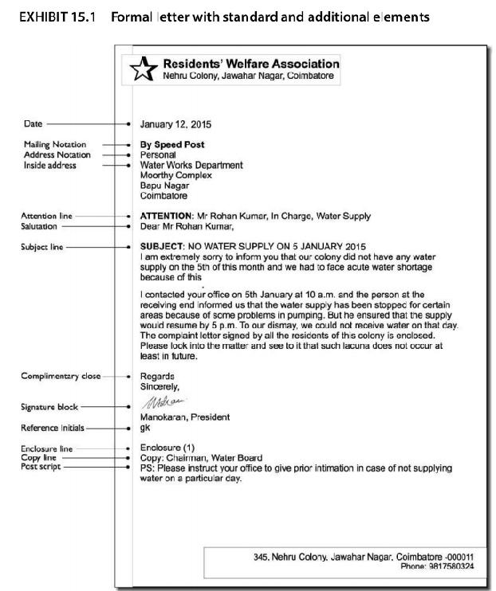

Slide 22
LAYOUT OF BUSINESS LETTER

Slide 23
Layout
Suitable and correct layout enhances the overall effectiveness of any letter. The layout helps to arrange all the elements of a formal letter in an organized manner. Although the basic parts of a letter have remained the same for centuries, the layouts have changed to quite an extent. Sometimes an organization adopts a certain format as its policy; sometimes the individual letter writer is allowed to choose the format most appropriate for a given letter or to settle on a personal preference. In general, two major letter layouts are widely used.

Slide 24
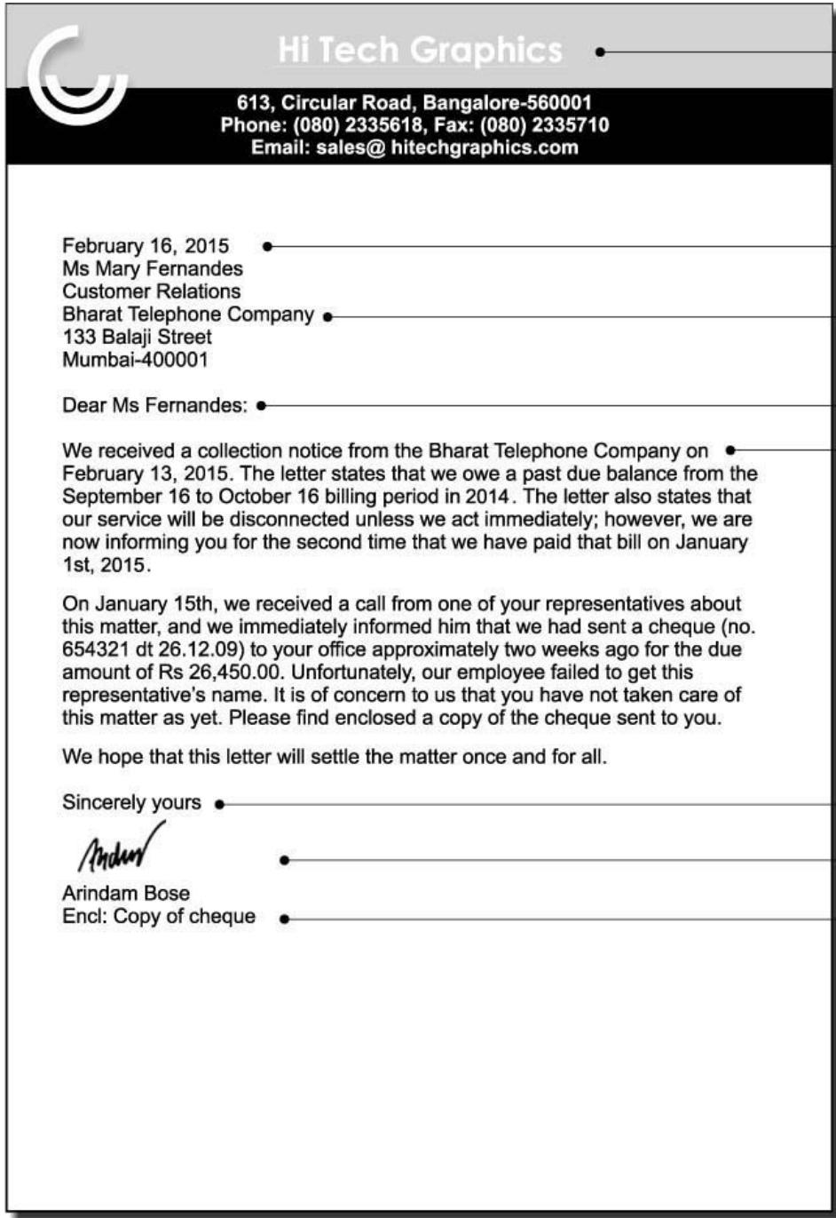
Block layout
The block layout, also known as the complete block layout is extremely popular as it makes the letter look attractive, elegant, and efficient.
The main characteristic of this layout is that all elements except the letterhead heading are aligned to the left margin.

Slide 25
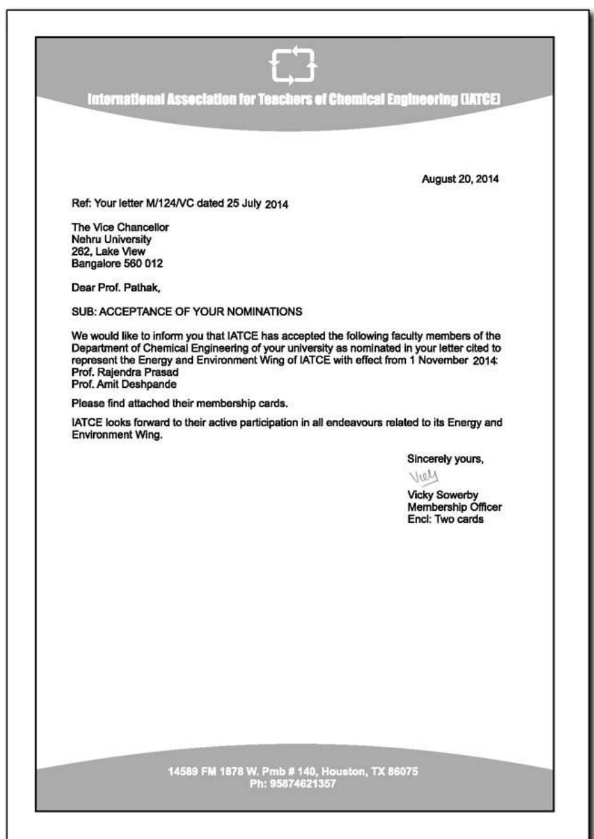
Modified Block layout
The modified block format differs from the block format in the positioning of certain elements: the heading is centre aligned whereas the dateline, complimentary close, and signature block are right-aligned. Although organizations seem to prefer the full block format, the modified block is also acceptable. The modified block’s appearance is often considered to be more balanced and traditional.

